Slide 1
Final Game:
Power Child
By Keller Hartig

Slide 2
Original Concept
When I first thought everything up, I bit off more than I could chew.
Too many levels
Working alone
I was too caught up in the cool idea that I had no sense of realism.
After jumping into Unity and starting everything off, I knew I had to dial it back a bit.
Professor Boyd also told me it was probably too much work
Refinement:
I trimmed off the other levels and focused on the code for the powerups, enemies, and the boss
As Professor Boyd suggested

Slide 3
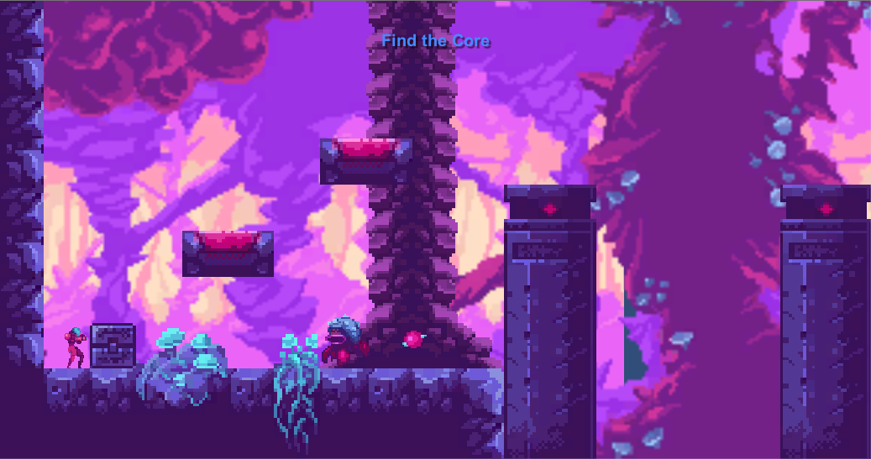
Final Concept
The main gameplay loop
Player moves through the level, picking up powerups while surviving the platforming and enemies
Eventually, they’ll reach the boss who they’ll have to outsmart through clever use of powerups

Slide 4
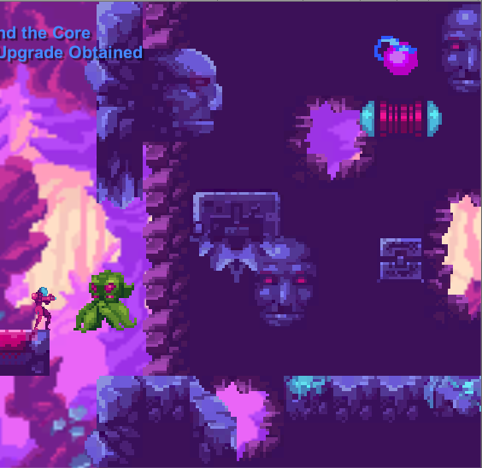
Development Successes
The music, menus, player-controls, platforming, and powerups all work well and feel good
The gameplay is successful in its purpose (in my opinion)
The beginning area is a tutorial, teaching the player to jump, shoot enemies, and collect powerups
The next area is a bit harder as the player will have a hard time crossing it without the jump powerup
The area nearing the boss has another powerup, and is a combination of platforms and enemies, testing the player’s skill
They will quickly learn that their bullets have little effect on the boss, so they’ll need to make a break for the core.

Slide 5
Development Challenges
Programming the enemies, boss, powerups, and animations all came with some challenges.
The boss in particular was incredibly difficult to make. I wanted it to feel hard to fight while not being too complicated to program.
The solution was to make the boss nearly invincible and force the player to go for the core instead of fighting it.
This solution works well with the code which tells the boss to follow the player.
Enemy and player respawn were also very difficult.
Had to find a way to respawn the player without deleting the object
Ended up hiding the player, and disabling them, before moving them to respawn.
Figuring out how to disable the player while respawning was the hardest roadblock I encountered
When I disabled the player and re-enabled them, parts of scripts would break.
My solution was to disable certain parts of their scripts instead of entire scripts.

Slide 6
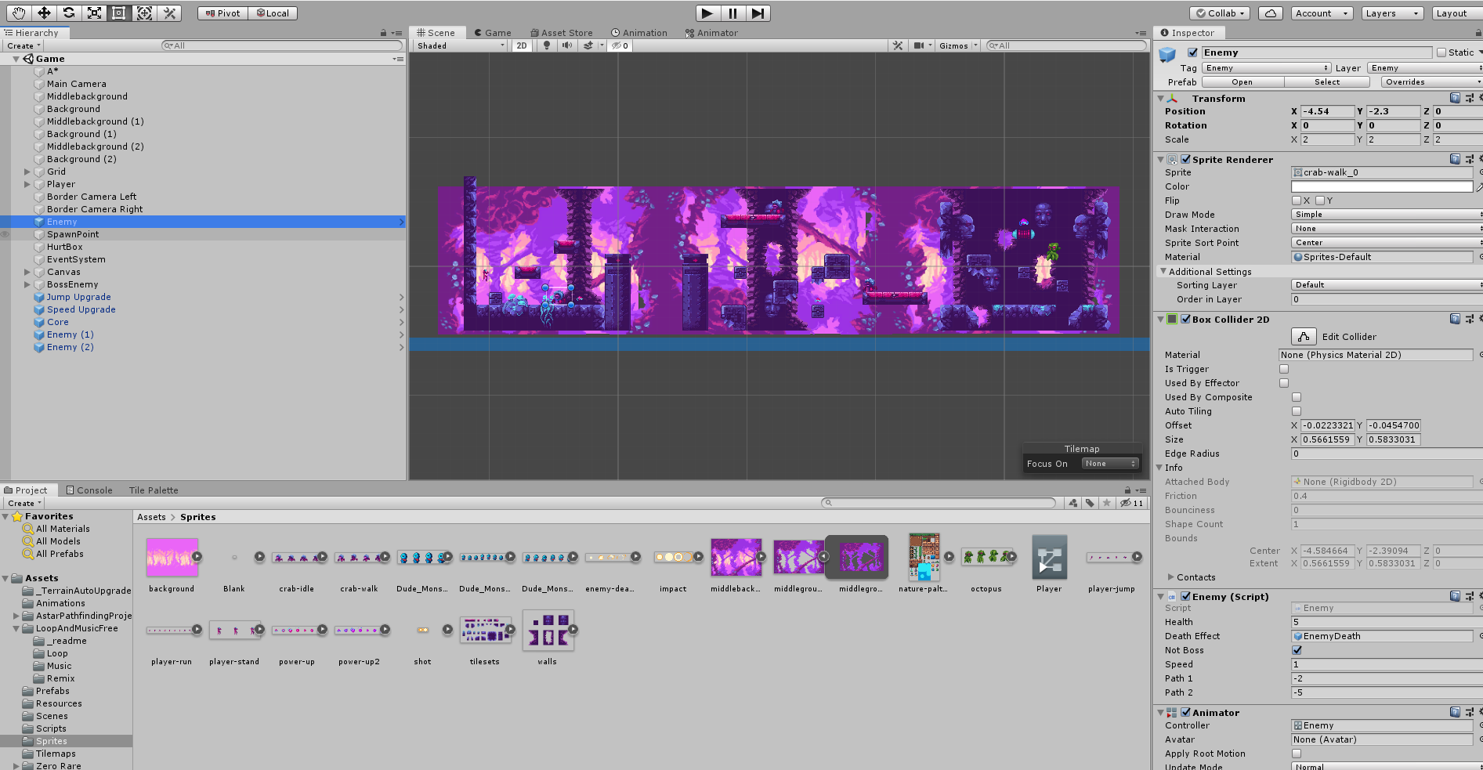
Development Look

Slide 7
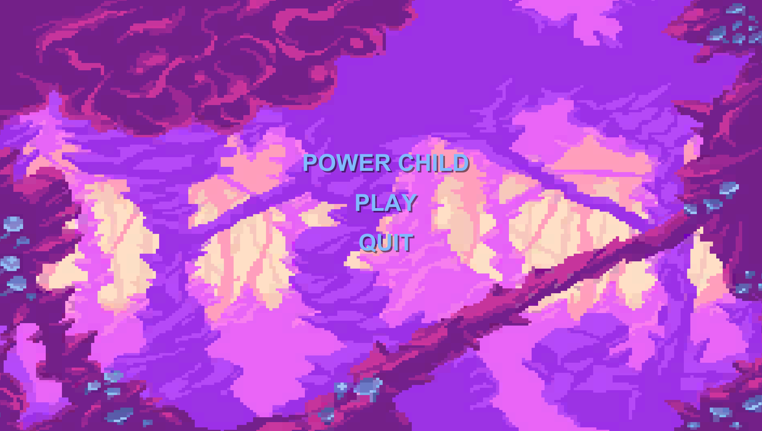
The Future of Power Child
I currently don’t plan to further develop Power Child, since it’s already a finished game and works on its own.
However, I will find a use for the skills I learned while making it
I already have ideas for more games to make.
Knowing how to use Unity is very useful, since now I have a way to visually represent my ideas

Slide 8
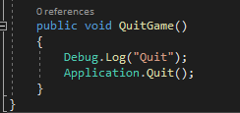
Closing Thoughts
Even though it was infuriating at times, I enjoyed making this game
With my little knowledge of programming, I’m proud of this accomplishment

